Slide 1
Knowledge Discovery Databases Predicting Wine quality
MIS 637
Professor Mahmoud Daneshmand
Submitted By
Kavya Ravavarapu

Slide 2
Abstract
The main goal of this project is to predict the quality of a bottle of wine in the range of 0 to 10 according to its composition. It is said that wine tasting and picking is an art which only few people can conquer.
I myself am a wine lover which pushed me towards this analysis.
I have chosen a data set from (https://archive.ics.uci.edu/ml/datasets/Wine+Quality) which describes 12 variables of wine where the target variable is “Quality of wine”

Slide 3
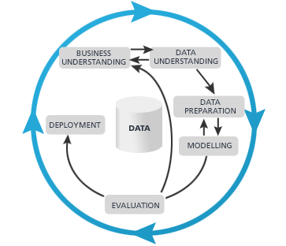
CROSS-INDUSTRY STANDARD PROCESS
(CRISP–DM)
Business understanding phase
Data understanding phase
Data preparation phase
Modeling phase
Evaluation phase
Deployment phase

Slide 4
Business Understanding
For this research, I have obtained a dataset which describes wine traits over 11 variables and to derive the target variable of quality. The objective of this research is to build a model, learned using historical data, that will determine the quality of red wine.
These datasets can be viewed as classification or regression tasks. The classes are ordered and not balanced (e.g. there are munch more normal wines than excellent or poor ones). Outlier detection algorithms could be used to detect the few excellent or poor wines. Also, we are not sure if all input variables are relevant.

Slide 5
Data Understanding
Data Source: This dataset was acquired form “https://archive.ics.uci.edu/ml/datasets/Wine+Quality”
Data set details: The data is straightforward. Each row represents one individual wine’s components/ingredients.
Each column contains the following variables input
1 - fixed acidity 2 - volatile acidity 3 - citric acid 4 - residual sugar 5 - chlorides 6 - free sulfur dioxide 7 - total sulfur dioxide 8 - density 9 - pH 10 - sulphates 11 - alcohol
Target variable is the quality of wine
The original dataset contains a total of 4883 rows with 1 dependent variable and 11 independent variables.

Slide 6
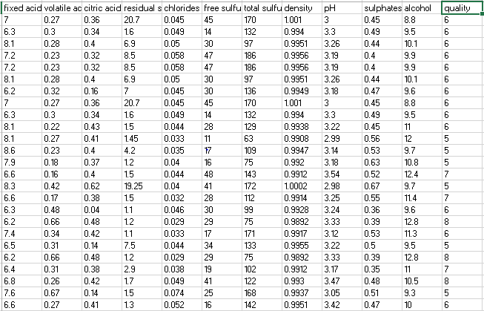
Sample data

Slide 7
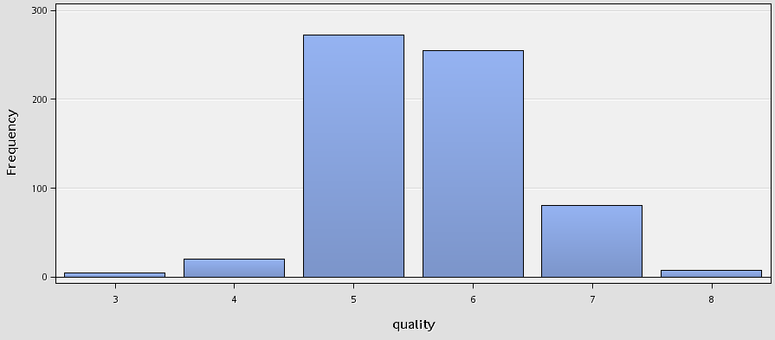
Data preparation
No missing values & outliers have been found in the data
It consists of 4883 records
Variables {fixed acidity, volatile acidity, citric acid, residual sugar, chlorides, free sulfur dioxide, total sulfur dioxide, density, pH, sulphates, alcohol }
Set up a data partition
Training 40%
Validation 30%
Test 30%

Slide 8
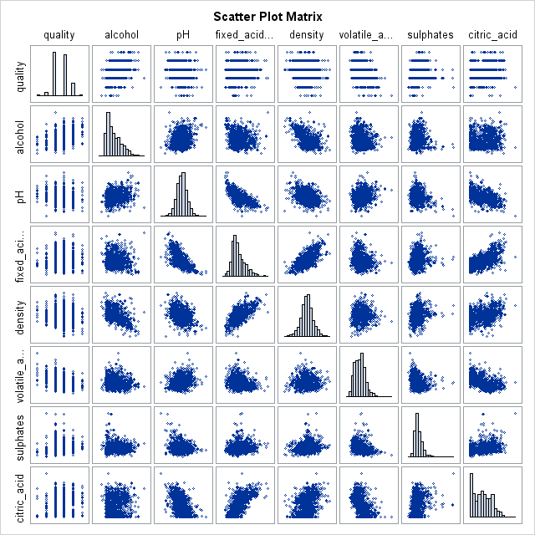
Scatter plot matrix
The variables all seem to have to contribute towards the deciding the quality of wine
There is definitely some correlation, but not variant enough to discard any variables

Slide 9

Data modelling
C4.5 algorithm: An extension of ID3 algorithm. C4.5 recursively visits each decision node, selecting the optimal splits, until no further splits are possible. It makes use of the concept of information gain or entropy reduction to select the optimal split.
Its better to follow decision tree algorithm as it provide us with descriptive leaves

Slide 10
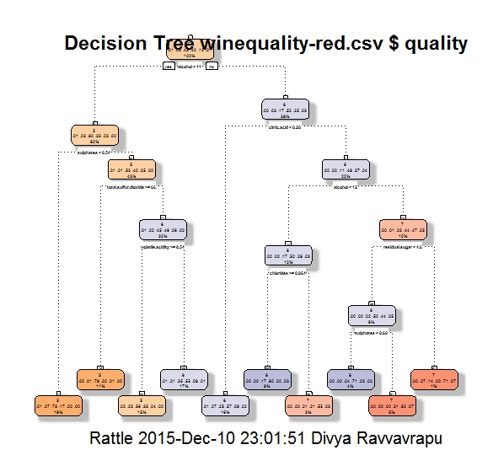
Decision tree

Slide 11
Rules : Tree as rules
Rule number: 22 [quality=5 cover=167 (15%) prob=59.00]
alcohol< 10.53
sulphates>=0.545
total.sulfur.dioxide< 65.5
volatile.acidity>=0.535
Rule number: 4 [quality=5 cover=211 (19%) prob=36.00]
alcohol< 10.53
sulphates< 0.545
Rule number: 60 [quality=6 cover=48 (4%) prob=34.00]
alcohol>=10.53
citric.acid>=0.275
alcohol>=11.55
residual.sugar< 4.65
sulphates< 0.685
Rule number: 23 [quality=6 cover=193 (17%) prob=107.00]
alcohol< 10.53
sulphates>=0.545
total.sulfur.dioxide< 65.5
volatile.acidity< 0.535
Rule number: 6 [quality=6 cover=178 (16%) prob=101.00]
alcohol>=10.53
citric.acid< 0.275
Rule number: 28 [quality=6 cover=103 (9%) prob=62.00]
alcohol>=10.53
citric.acid>=0.275
alcohol< 11.55
chlorides>=0.0635

Slide 12
Rules : Tree as rules
Rule number: 10 [quality=5 cover=121 (11%) prob=24.00]
alcohol< 10.53
sulphates>=0.545
total.sulfur.dioxide>=65.5
Rule number: 61 [quality=7 cover=55 (5%) prob=17.00]
alcohol>=10.53
citric.acid>=0.275
alcohol>=11.55
residual.sugar< 4.65
sulphates>=0.685
Rule number: 29 [quality=7 cover=29 (3%) prob=6.00]
alcohol>=10.53
citric.acid>=0.275
alcohol< 11.55
chlorides< 0.0635
Rule number: 31 [quality=7 cover=14 (1%) prob=0.00]
alcohol>=10.53
citric.acid>=0.275
alcohol>=11.55
residual.sugar>=4.65

Slide 13
Data modelling
Random Forests algorithm: Random Forests grows many classification trees. To classify a new object from an input vector, put the input vector down each of the trees in the forest. Each tree gives a classification, and we say the tree "votes" for that class. The forest chooses the classification having the most votes (over all the trees in the forest).
These datasets can be viewed as classification tasks. The classes are ordered and not balanced (e.g. there are much more normal wines than excellent or poor ones). Outlier detection algorithms could be used to detect the few excellent or poor wines. Also, we are not sure if all input variables are relevant.

Slide 14
Data modelling
Each tree is grown as follows:
If the number of cases in the training set is N, sample N cases at random - but with replacement, from the original data. This sample will be the training set for growing the tree.
If there are M input variables, a number m<<M is specified such that at each node, m variables are selected at random out of the M and the best split on these m is used to split the node. The value of m is held constant during the forest growing.
Each tree is grown to the largest extent possible. There is no pruning.
The correlation between any two trees in the forest. Increasing the correlation increases the forest error rate.
The strength of each individual tree in the forest. A tree with a low error rate is a strong classifier. Increasing the strength of the individual trees decreases the forest error rate.

Slide 15
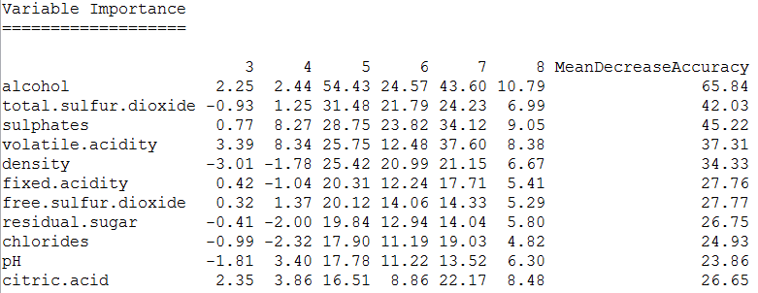
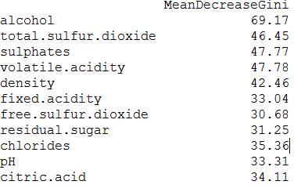
Random Forests algorithm results

Slide 16
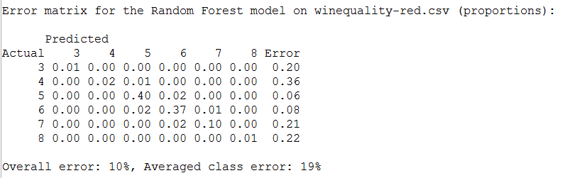
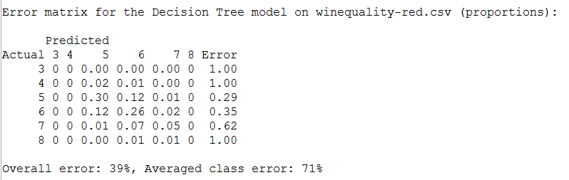
Error rates

Slide 17
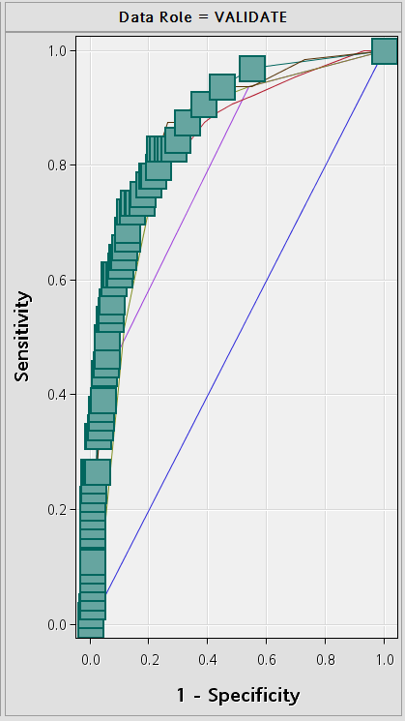
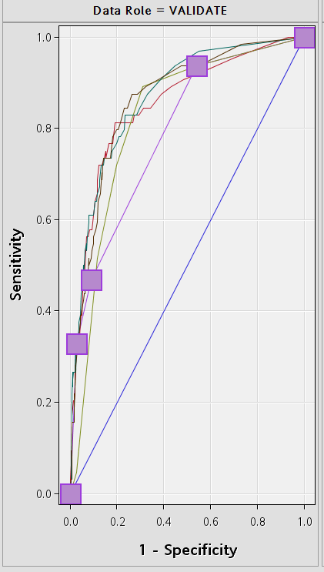
ROC curves
Random Forests algorithm
C4.5 algorithm

Slide 18
Comparison
The ROC Curves show good predictive results for both the algorithms
Whereas, error rate is higher for Decision tree algorithm when compared to Random forest algorithm
I conclude this research to be more fruitful when applied random forest algorithm

Slide 19
Deployment
This model could of great use for major alcohol chains( selling alcohol) to pick the right kind of wines
To be used by wine manufacturers and vineyards to understand which wines are of best quality
Could be developed into an application which could be used by all the wine lovers who want to pick the right wines for occasions

Slide 20
References
UCI Machine Learning Repository https://archive.ics.uci.edu/ml/datasets/Wine+Quality
P. Cortez, A. Cerdeira, F. Almeida, T. Matos and J. Reis. Modeling wine preferences by data mining from physicochemical properties. In Decision Support Systems, Elsevier, 47(4):547-553, 2009.
P. Cortez, A. Cerdeira, F. Almeida, T. Matos and J. Reis. Modeling wine preferences by data mining from physicochemical properties. In Decision Support Systems, Elsevier, 47(4):547-553, 2009

Slide 21
Thank you

